Slide 1
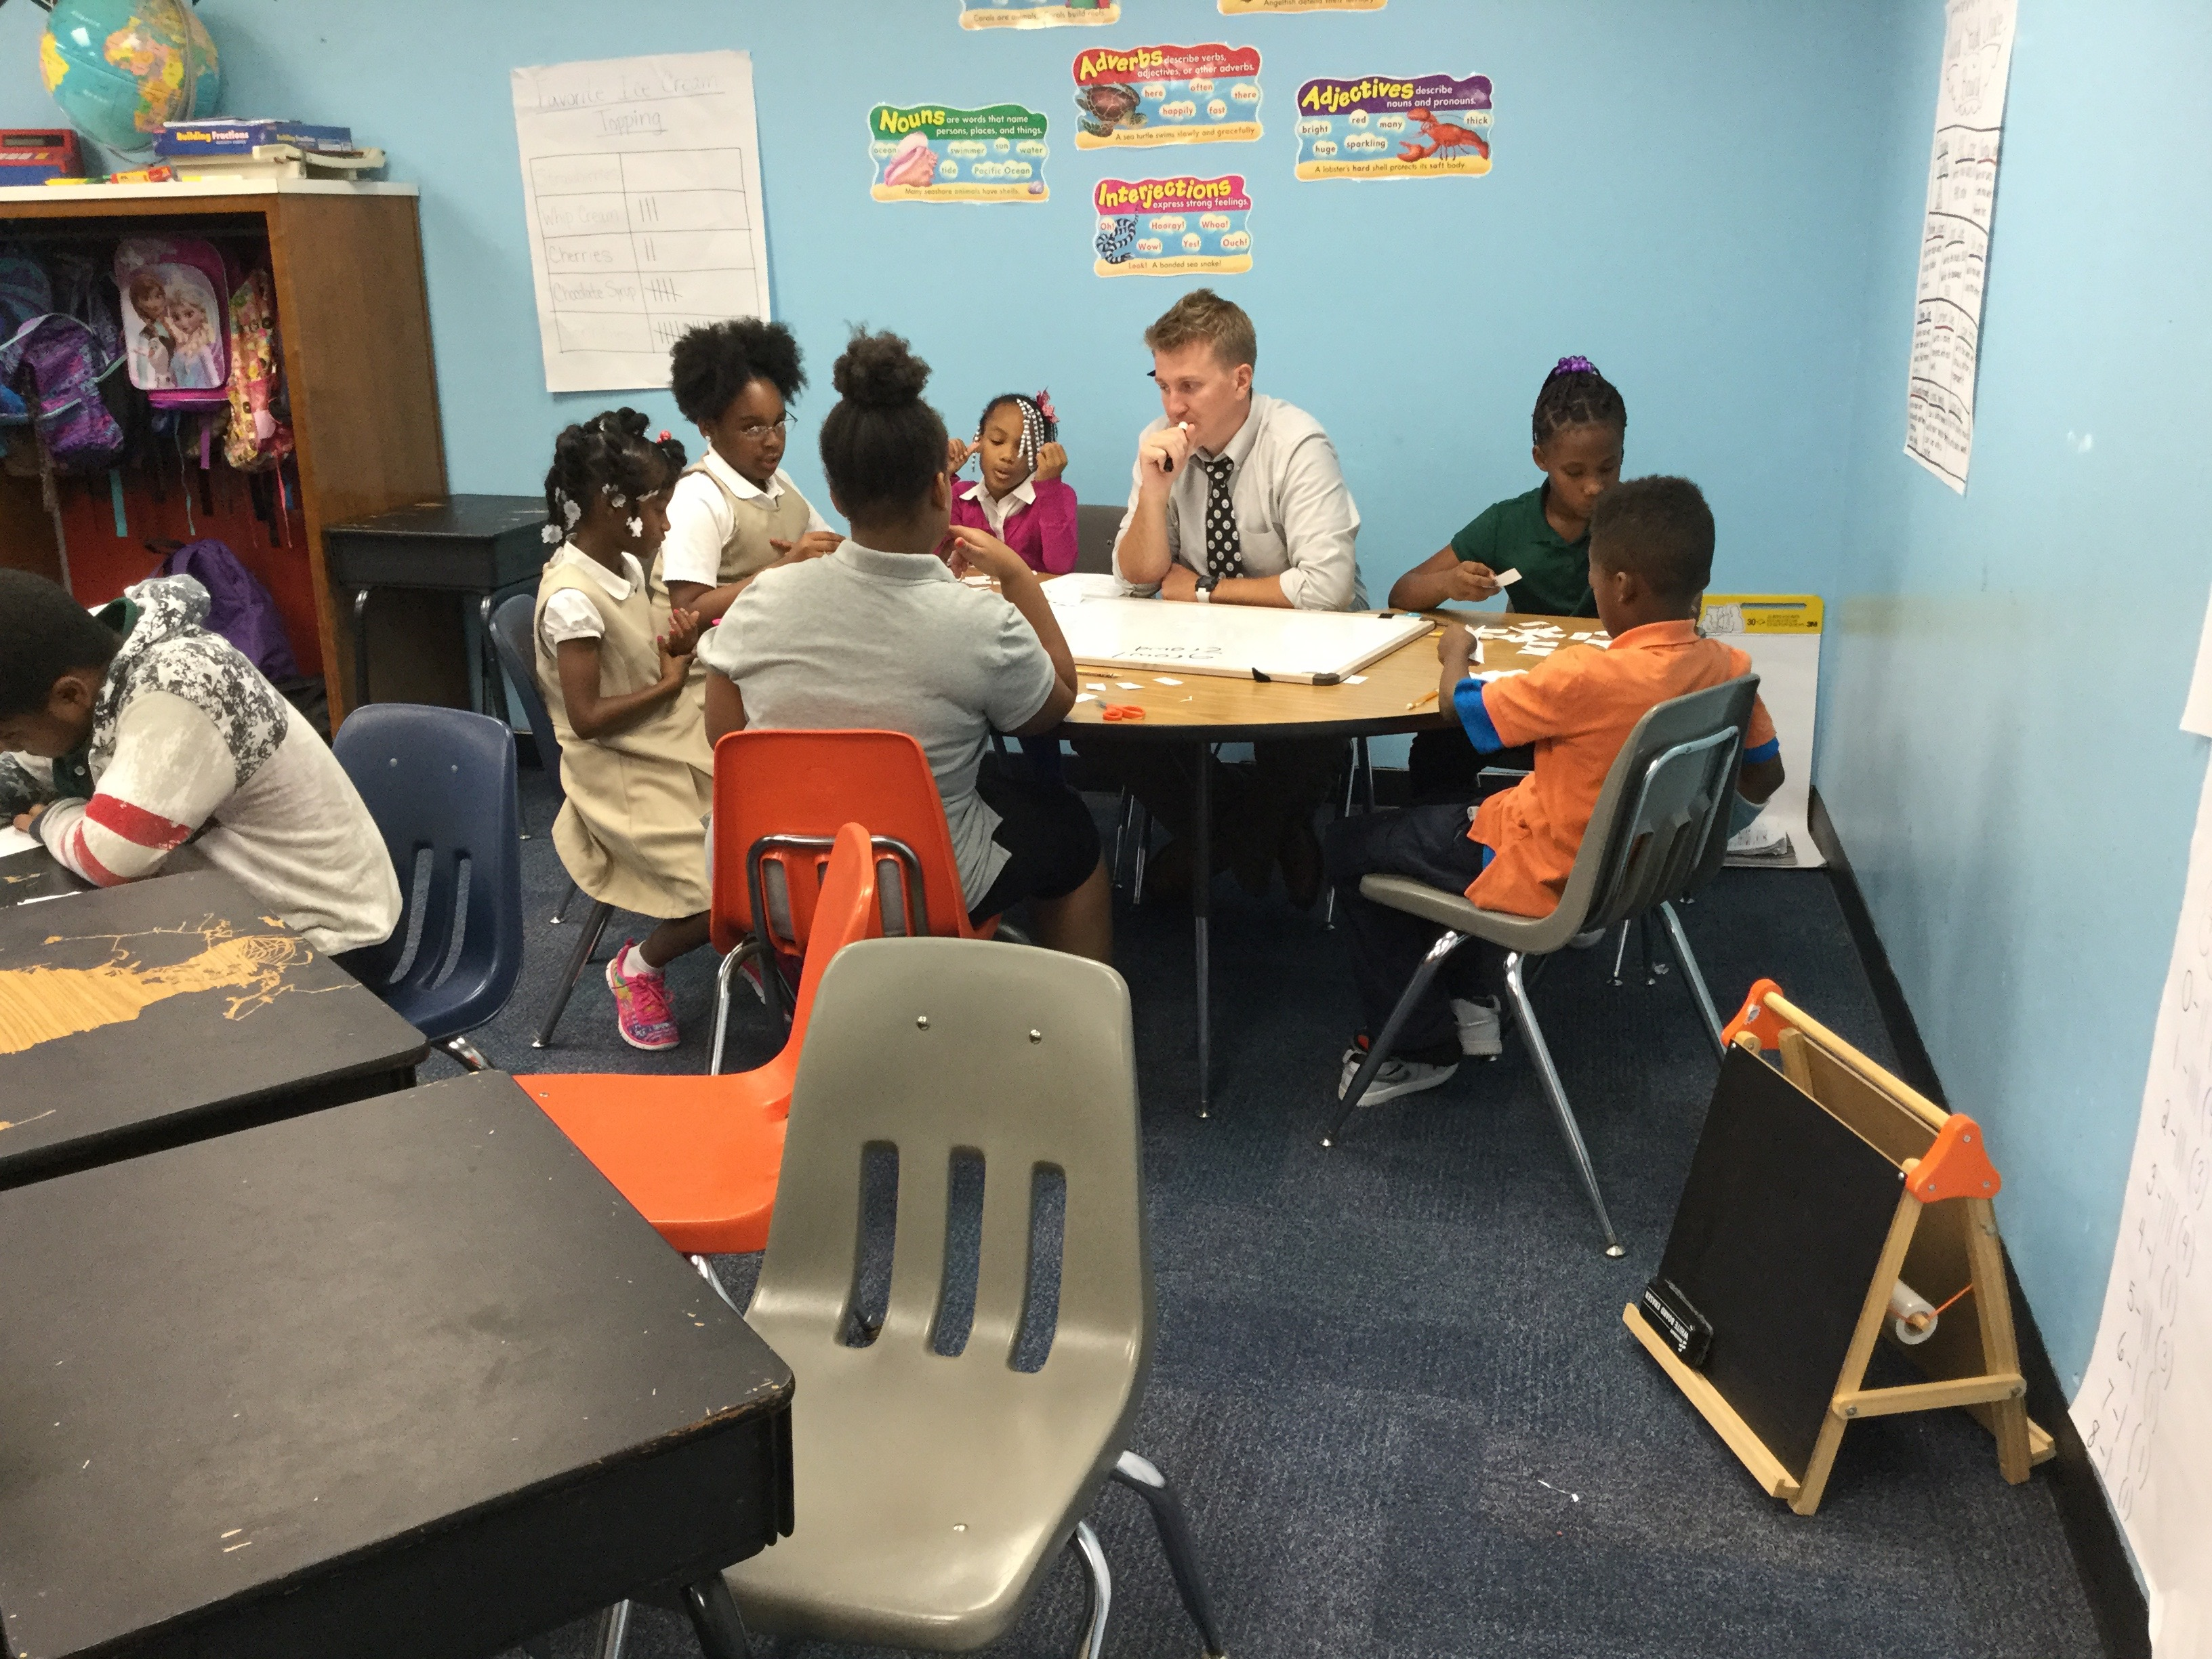
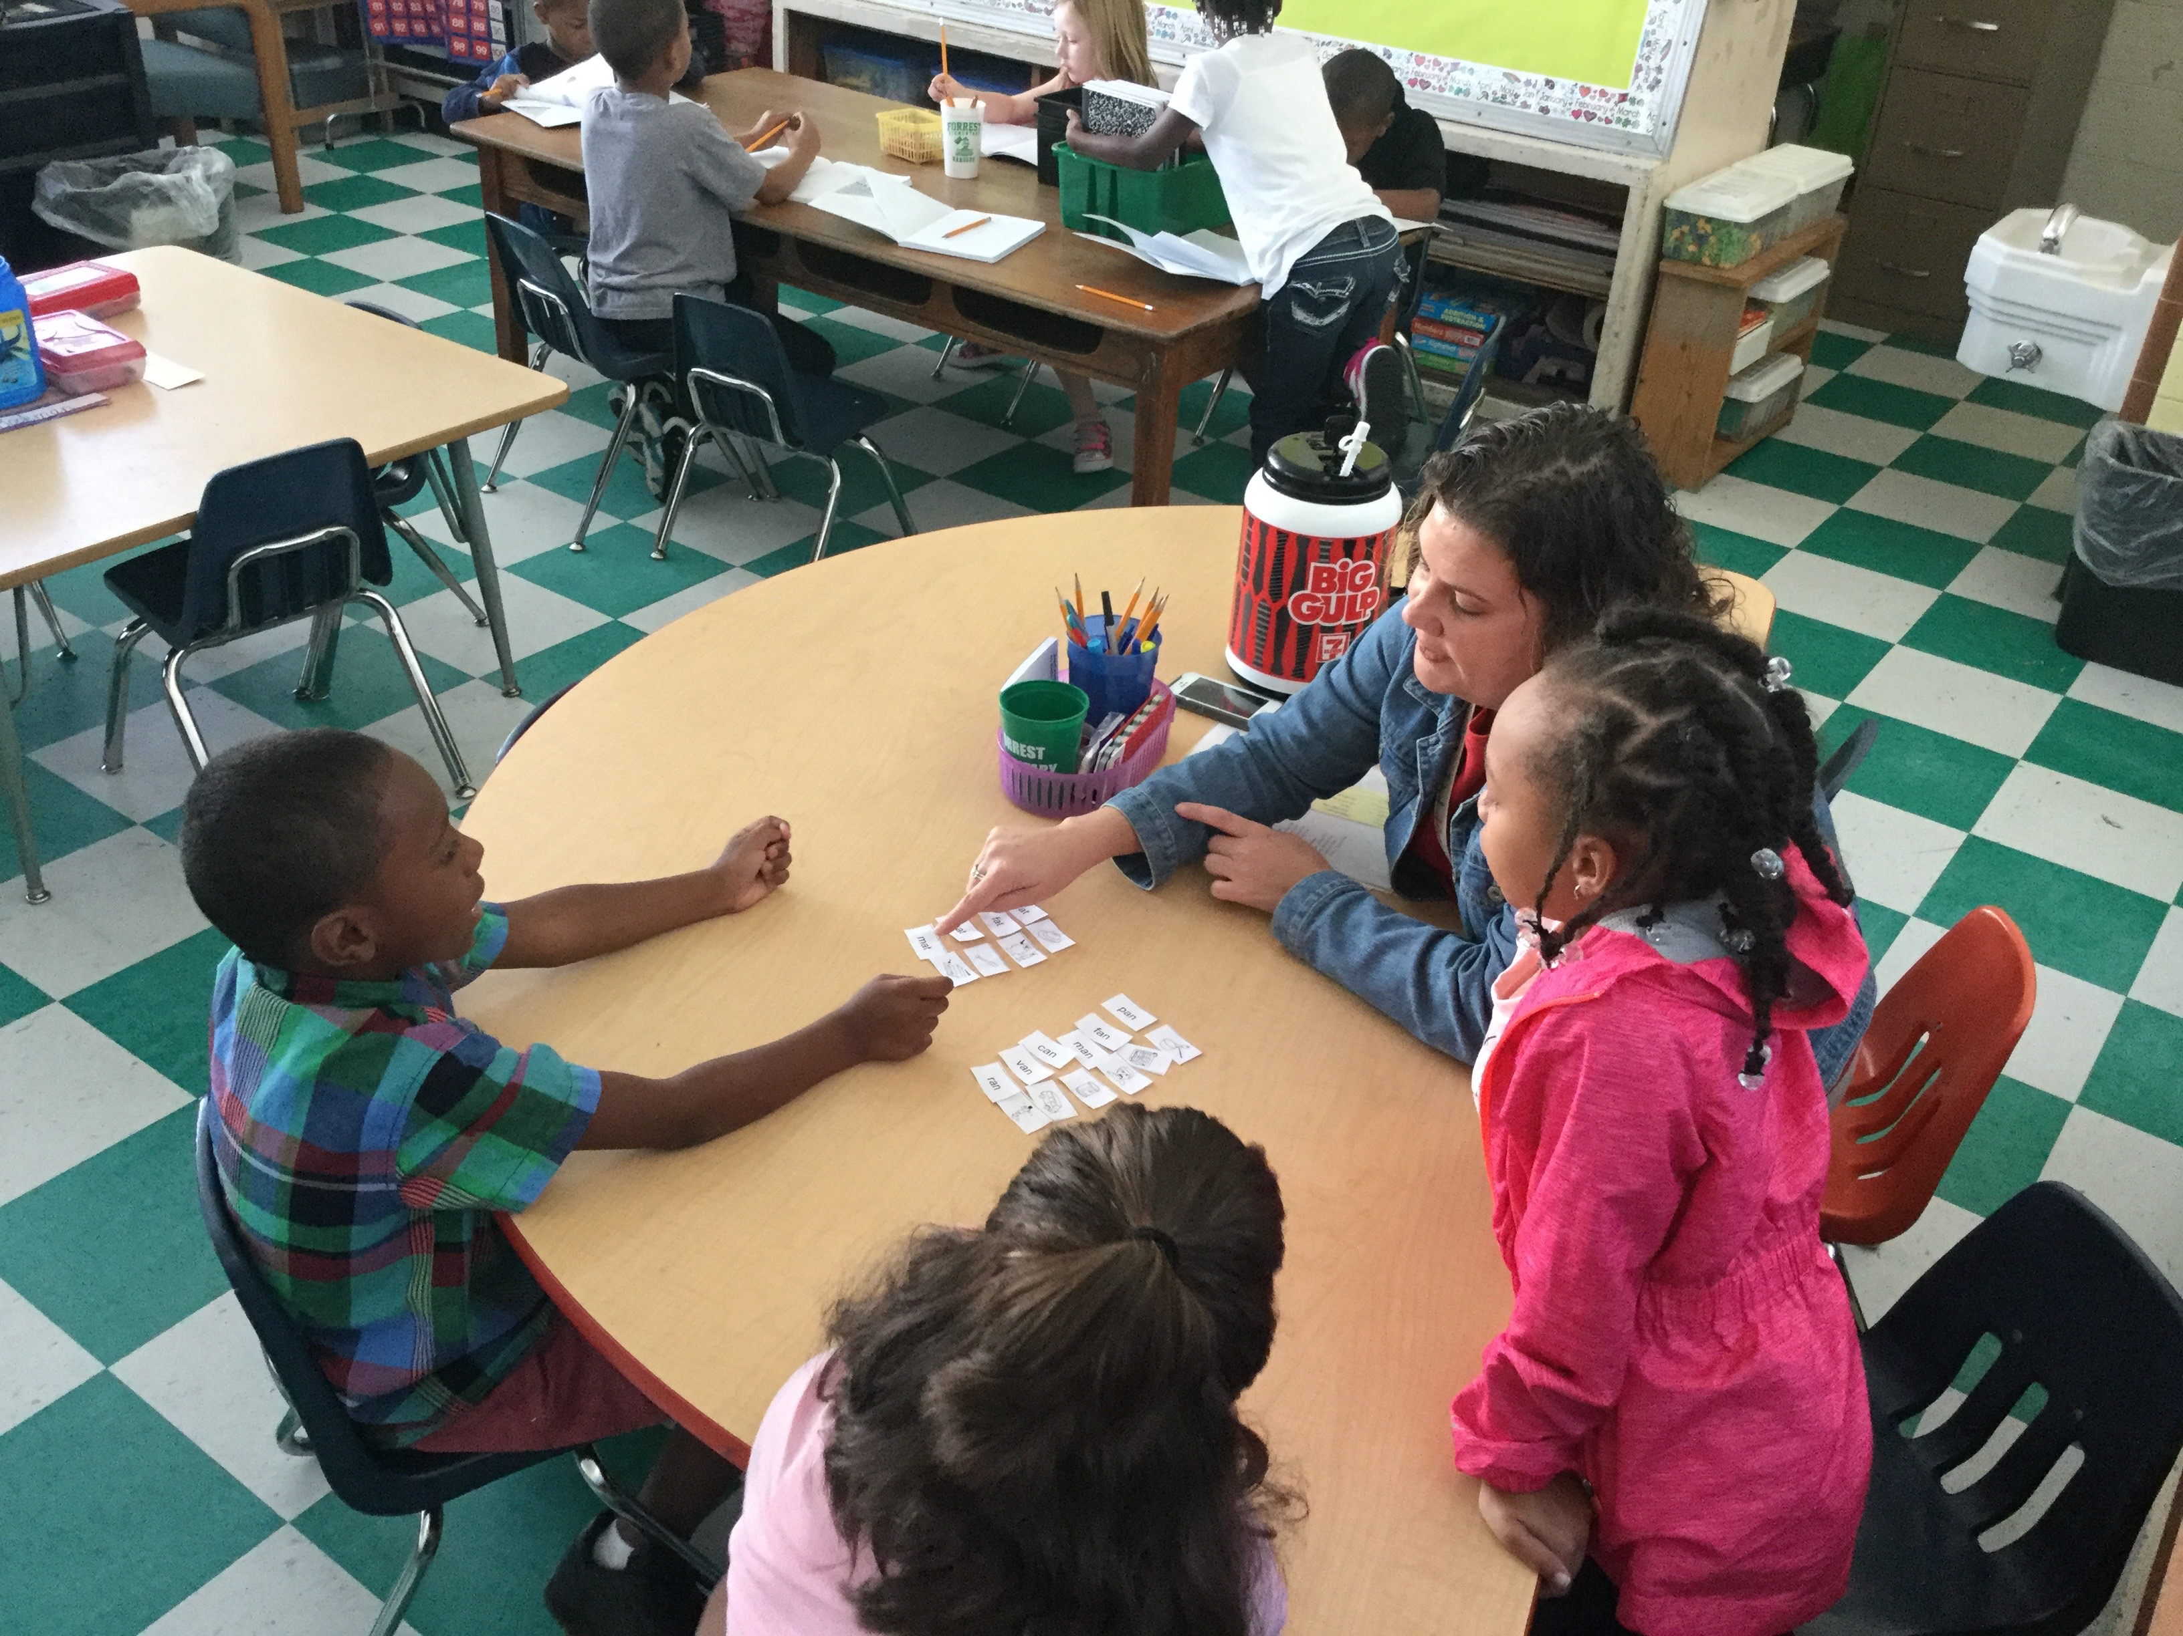
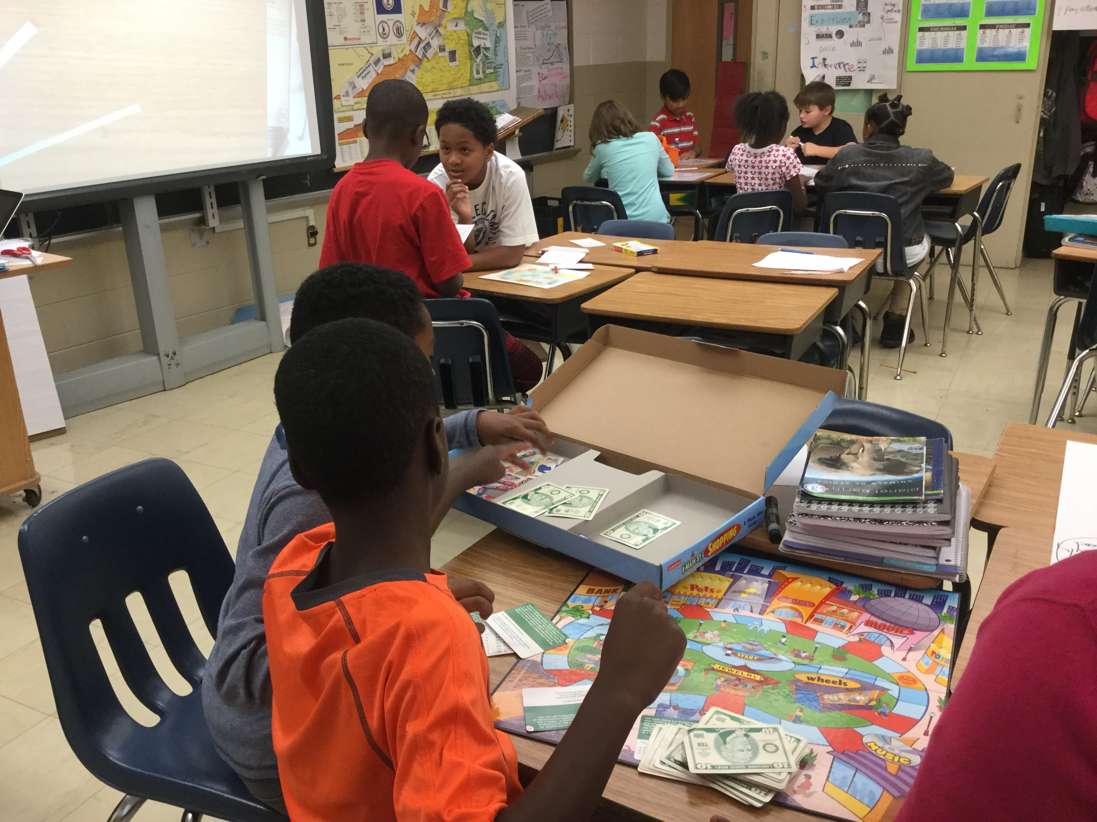
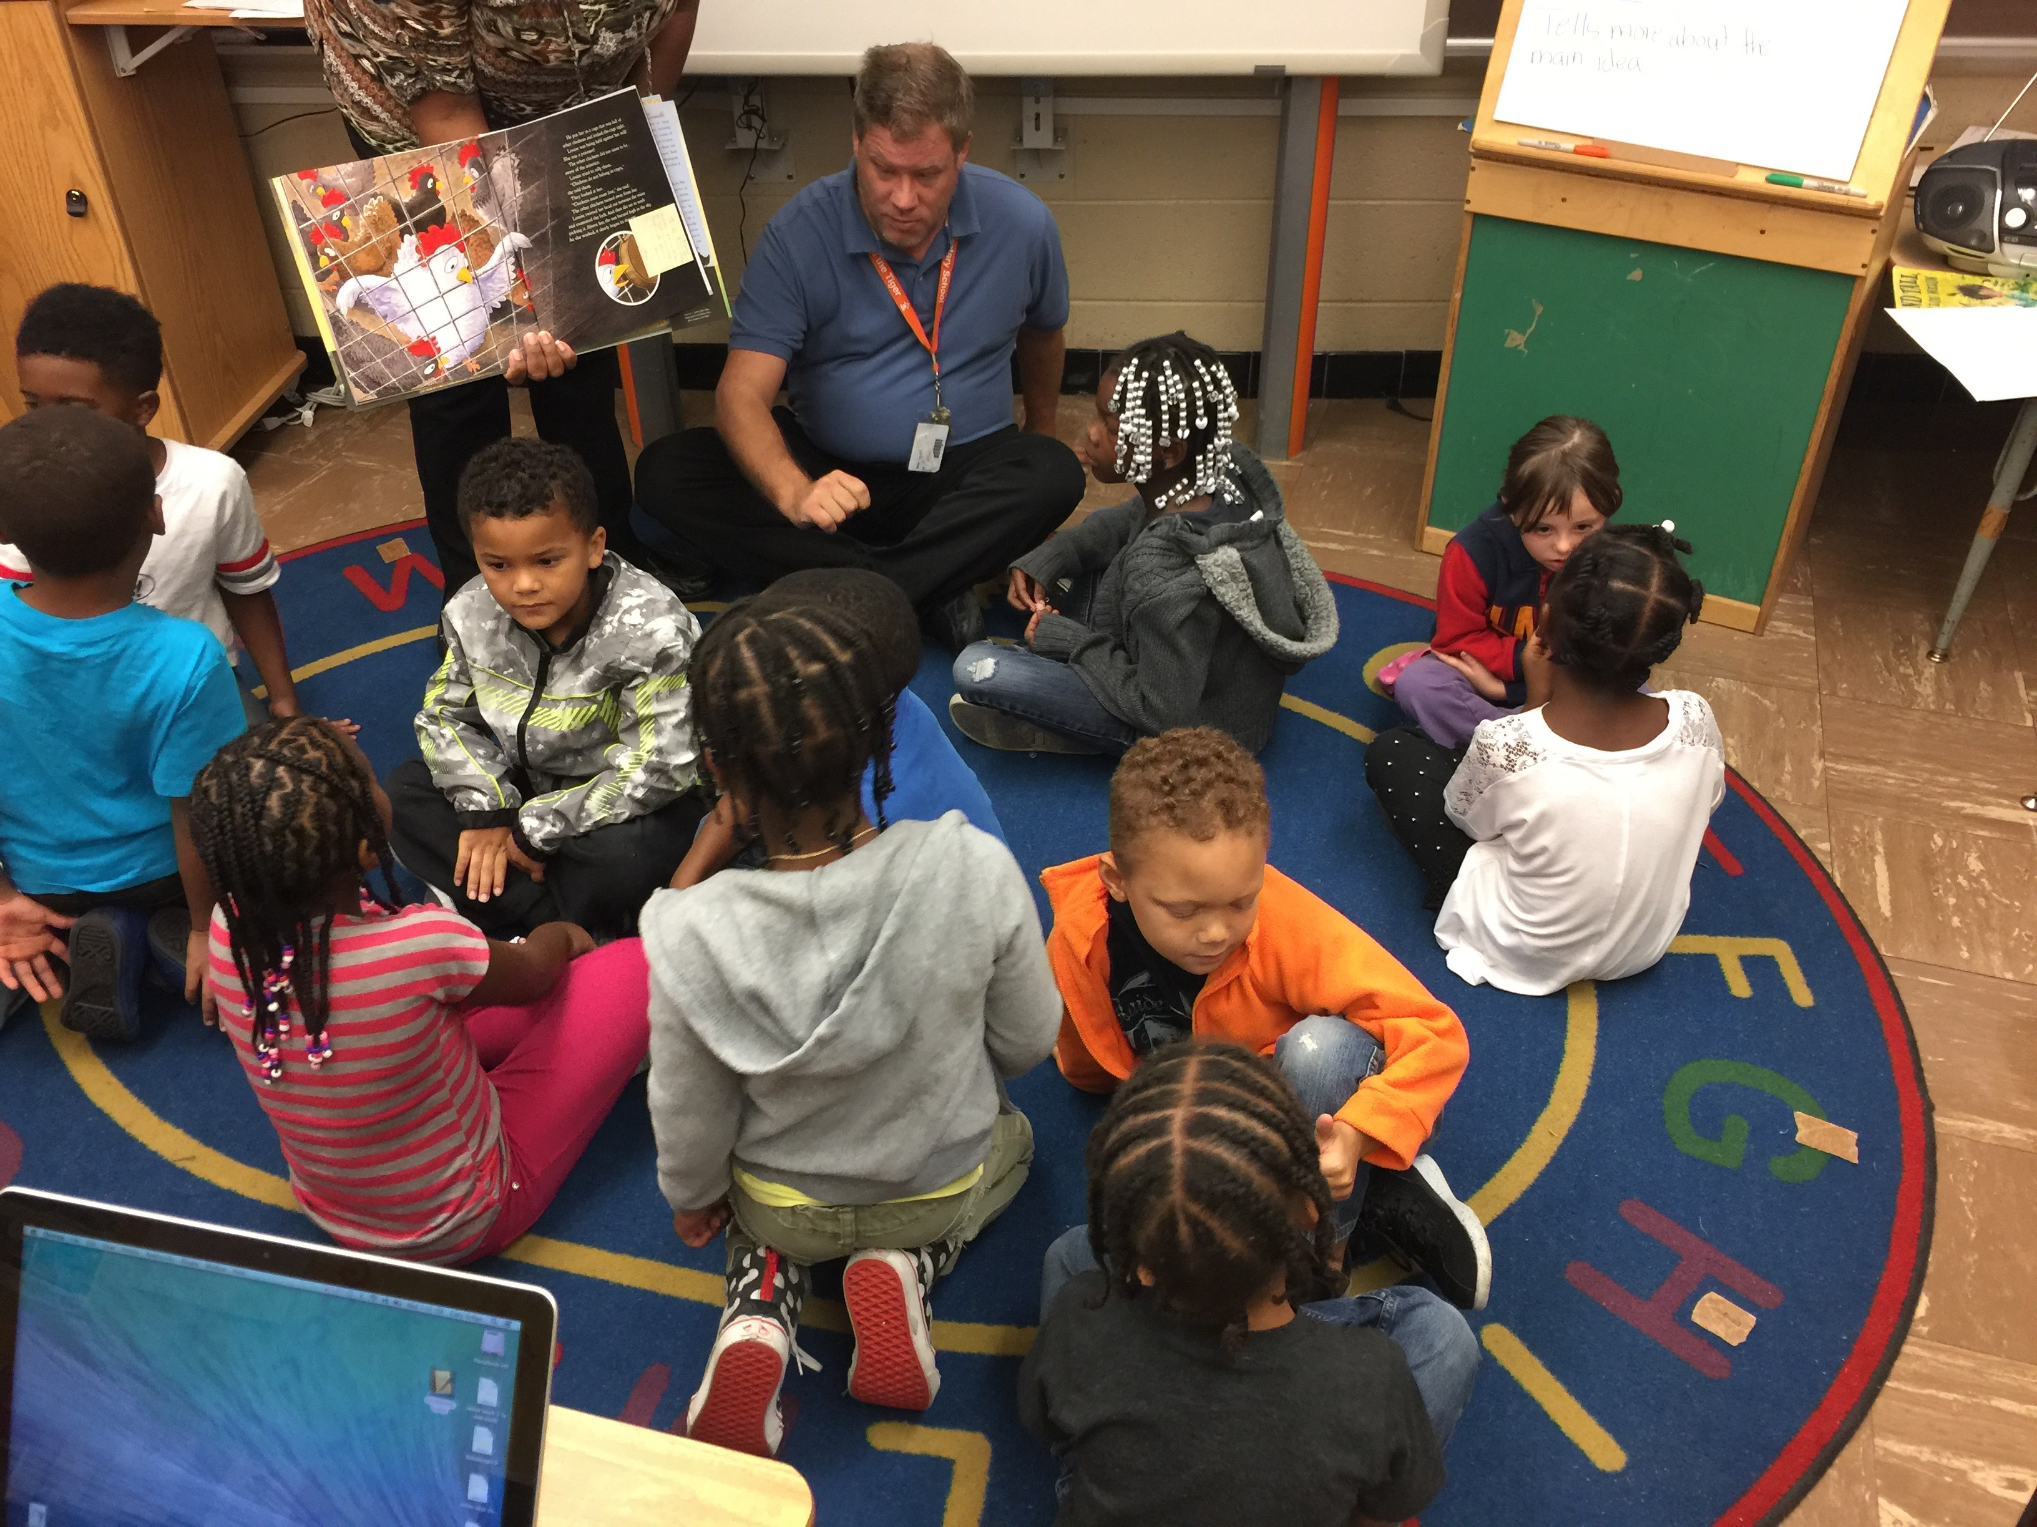
15 Minute Walkthroughs
Observing a Balanced Literacy Diet with the tools of Leverage Leadership

Slide 2
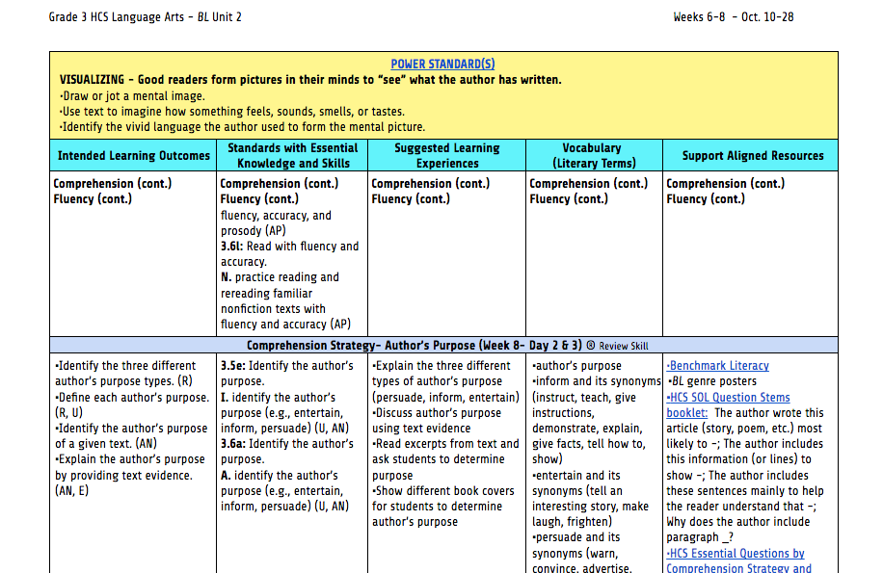
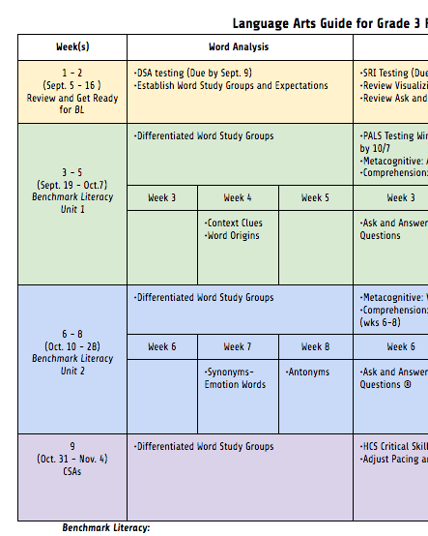
Entering the classroom…
Look and listen for the current Learning Intention & Success Criteria throughout the lesson
Access the CIA website for grade level Pacing Guide to locate the corresponding HCS Learning Plan.
Are Lesson Plans aligned?

Slide 3
Whole Group Reading connects the comprehension & metacognitive strategies
Read aloud
Chosen from Book Room or BML trade books
Display text on Promethean Board or document camera
Model Metacognitive strategy (anchor charts, graphic organizer, “turn & talk”)
Utilize all week with pre-selected stopping points
Mini-Lesson
BML materials: big books, posters, text, readers’ theater
Comprehension strategy
Model comprehension strategy (anchor charts, graphic organizer, “turn & talk”)
K-2: M-F 30 min Shared Reading; 10 Read-Aloud/20 Mini-Lesson
3-5: Monday 45-55 min Shared Reading
3-5: T-F 10 10 Read-Aloud/20 Mini-Lesson

Slide 4
Small Group Reading connects the comprehension & metacognitive strategies
Teacher directed
Select leveled readers from Book Room or BML Resources (on-line and books) Pull up the RTI database for correlated levels.
Students actively engaged through graphic organizer, connecting writing to text, …
Appropriate Word Study materials
Differentiated instruction based on Stages of Reading
Emergent-focus on phonological awareness, alphabet knowledge, concept of word
Beginning- focus on phonics and sight word development
Transitional-focus on fluency and comprehension
Intermediate/Advanced- comprehension and vocabulary

Slide 5
Whole Group/Small Group Questioning

Slide 6
Small Group Instruction Practice connects the comprehension & metacognitive strategies
Independent extension of small group instruction
Select leveled readers from Book Room or BML Resources (on-line and books)
Students actively engaged through graphic organizer, connecting writing to text, …
Differentiated instruction based on Stages of Reading
Emergent-focus on phonological awareness, alphabet knowledge, concept of word
Beginning- focus on phonics and sight word development
Transitional-focus on fluency and comprehension
Intermediate/Advanced- comprehension and vocabulary

Slide 7
Reading Workstation/Independent Reading
Students choose Just Right Text (ARC book baskets, BLM or on-line library) or ebooks based on PALS/DRA/SRI level.
Set a purpose for reading- utilize reading log, reader’s response…

Slide 8
Literacy/Writing Work Stations
Independent Practice
SOL grade level activities
Grammar and Writing practice
Readers’ Theater resources
Activities linked in curriculum

Slide 9
Writing 25-30 minutes daily
Teacher directed based on learning plan
K-2- Writer’s Workshop projects
3-5 utilize HCS card, Burger Model, Story Boards, and Benchmark Writing Workshop.

Slide 10
Word Study K-2: 22-30 min. daily 3-5: M-60-80 min; T-F 5-7 min at the beg. of Small group
Differentiated instruction based on PALS & DSA
Teacher modeling by sound, pattern, meaning
Introduce headers and model feature
Students actively engaged through graphic organizer, connecting writing to text, …
Appropriate practice of Word Study materials; to include Speed Sort, Blind Sort, Buddy Sort to re-inforce feature
Use text that incorporates WS features
Ensure that students have correct sort in notebook

Slide 11
Questions

