Slide 1
Celebrate the best to evoke the best Part 4
Bob & Megan Tschannen-Moran, Kathleen Pietrasanta

Slide 2
Celebrate the best to evoke the best Part 4
Kathleen Pietrasanta. Butler Knight

Slide 3
Salubrious Success
Share a short story about
Story Listening
Coaching Presence
Appreciative Inquiry Principle
Positive energy/emotion
Positive conversation/interaction
Positive question/reflection
Positive present/vision

Slide 4
Ds of Disconnection
Diagnosing person as the problem
Denying responsibility
Demanding
Deserving consequences

Slide 5
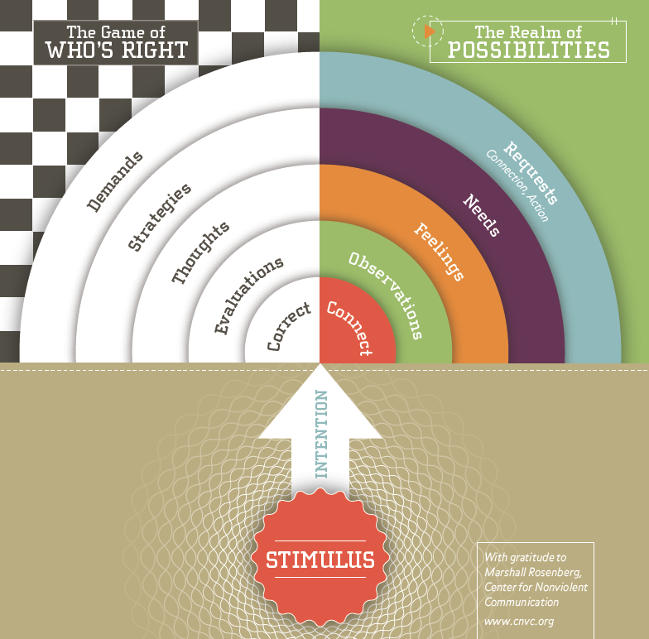
Compassionate Communication

Slide 6
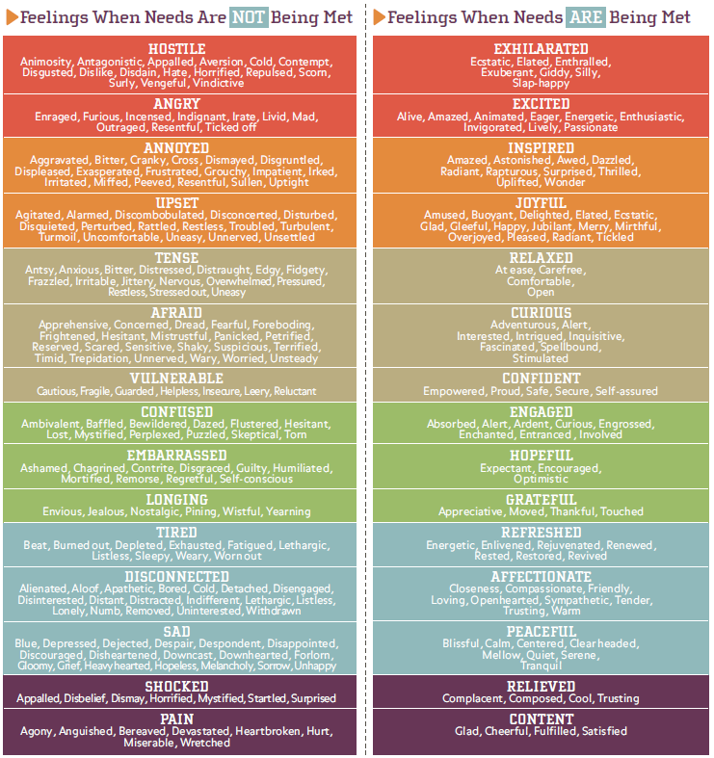
Feelings

Slide 7
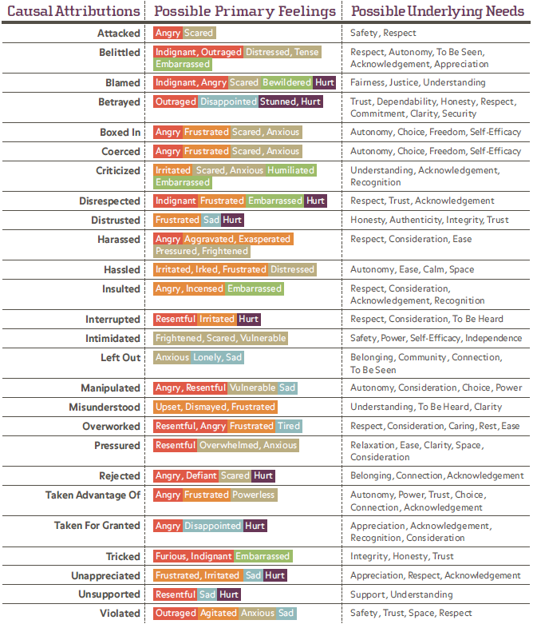
Faux Feelings

Slide 8
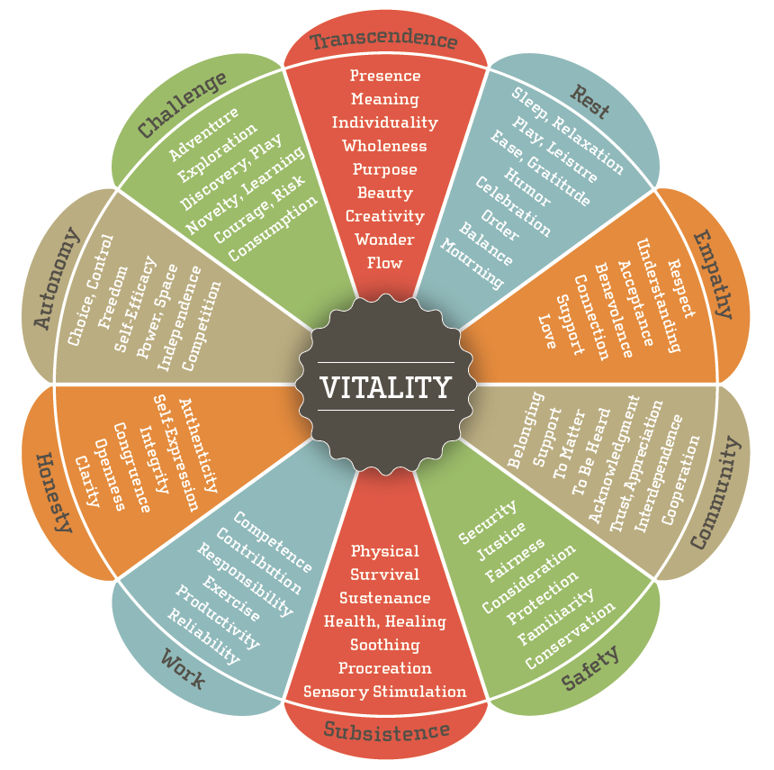
The Wheel of Needs

Slide 9
Fishbowl Volunteer
An experience with another person whose behavior you are not enjoying

Slide 10
Triad Practice
 | STORY | FEELINGS | NEEDS
Round 1 | A | B | C
Round 2 | B | C | A
Round 3 | C | A | B

Slide 11
Readiness to Change
CORRECTION CONNECTION
COMPETENCE CONFIDENCE
CAUSES CAPACITIES
COUNTERFORCE COUNTERBALANCE

Slide 12
WHEEL OF NEEDS
Where or how need is currently met
Brainstorm ideas for meeting or honoring

Slide 13
Homework for January
READ
Chapter 2 and Interlude: Loop 1 (p.55-57)
Appreciative Empathy article in Groupsite https://schooltransformation.groupsite.com/uploads/flies/x/000/075/845/Appreciative_Empathy.pdf?1352933682
PRACTICE
A conversation that focuses on reflecting feelings and needs
EXPAND
Use Reflection Sheet when listening to a recorded coaching conversation in Groupsite
https://schooltransformation.groupsite.com/file_cabinet
COMPLETE
Class Valuation Survey

